Slide 1

Electrical Machinery Fundamentals
EE 250 SPRING 2020
Lecture 4
1

Slide 2
Chapter 6 Efficiency and Heating of Electrical Machines

Slide 3
6.1 Mechanical losses
Mechanical losses are due to:
Bearing friction
Brush friction
Windage (Air friction)
Mechanical losses depends upon:
Speed of machine
Design of bearings, brushes, commutator and slip rings
Rotating machines are cooled by internal fans mounted on the shaft (Draws in air from surroundings, blows over the windings and expels through suitable vents)

Slide 4
6.2 Electrical losses
6.2.1 Conductor losses (I²R)
6.2.2 Brush losses
6.2.3 Iron losses

Slide 5
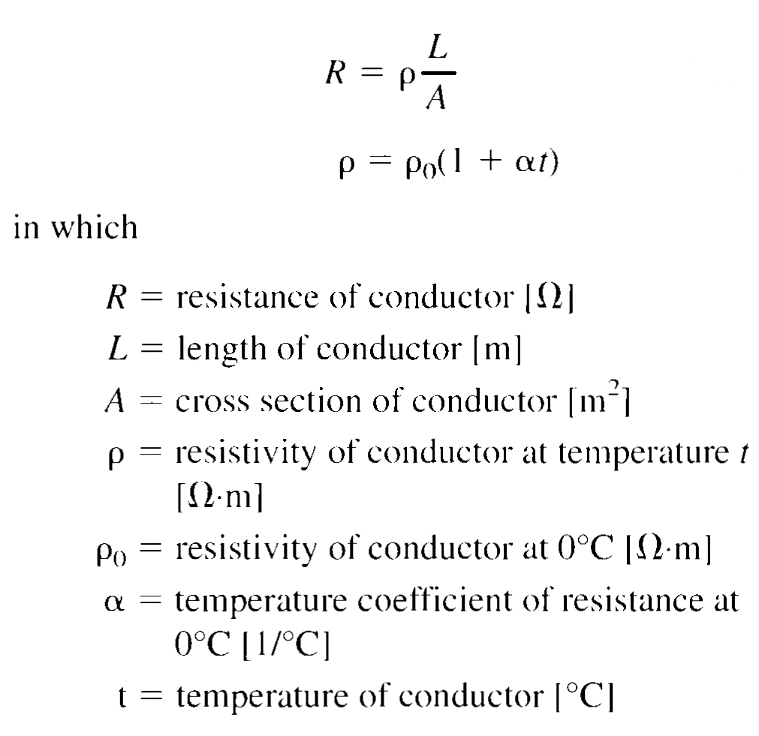
6.2.1 Conductor losses (I²R)
Conductor losses depends upon:
Resistance (Depends upon length, cross-sectional area, resistivity and temperature of conductor)
Square of current it carries.

Slide 6
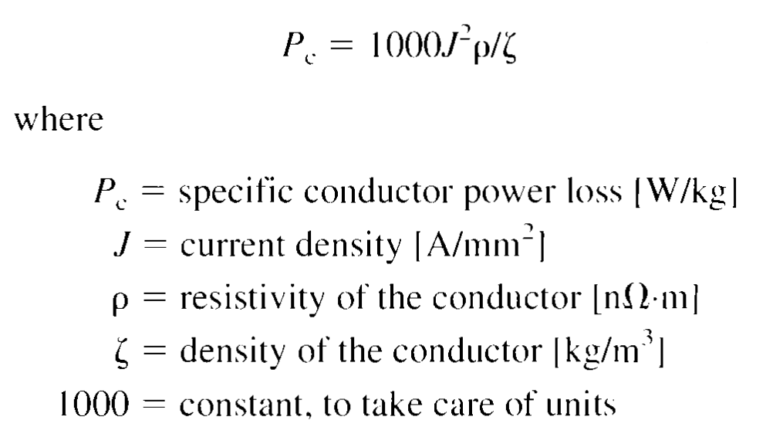
6.2.1 Conductor losses (I²R)
In dc motors and generators conductor losses can occur at:
Armature
Series field
Shunt field
Commutating poles
Compensating windings
Conductor losses may show up heating resulting in the rising of machine temperature
Sometime its prefer to express conductor losses in terms of the number of watts/kg of conductor material

Slide 7
6.2.2 Brush losses
I²R losses in the brushes are negligible due to low current density (0.1 A/mm²)
Brush losses depends upon:
Contact voltage drop between brushes and commutator may produce significant loss
Voltage drop varies from 0.8 V to 1.3 V and depends upon:
Type of brush
Applied pressure
Brush current

Slide 8
6.2.3 Iron losses
Iron losses are produced in the armature of DC machines and are due to hysteresis and eddy currents
Iron losses depends upon:
Magnetic flux density
Speed of rotation
Quality of iron
Size of armature

Slide 9
6.3 Losses as a function of load
DC motor at no-load develops no useful power but it absorbs power from line to continue to rotate, this no-load power is used to overcome friction, windage and iron losses.
I²R losses in the armature, series field and commutating field is negligible because no-load current is low
under loading the machine the armature current increases and thus I²R losses increases
Other losses almost remain constant

Slide 10
6.3 Losses as a function of load
DC motor at no-load develops no useful power but it absorbs power from line to Total losses of machine increases with increasing load=> these losses are converted to heat and they increases the temperature of machine
Limitation to temperature rise and rated output power
Overloaded machine will heat up
Insulation will burn-out
We can overload the machine for a short period of time

Slide 11
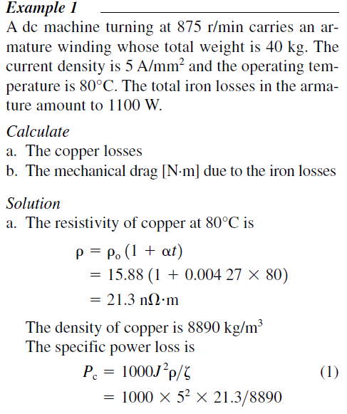
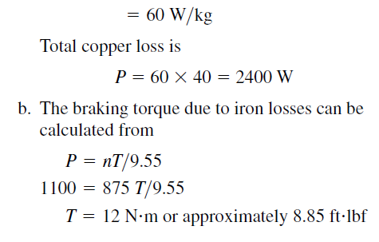
6.3 Losses as a function of load

Slide 12
6.4 Efficiency curve
Efficiency of a machine is the ratio of useful output power P_{o} to the input power P_{i.}
Here, input power=useful power + losses p

Slide 13
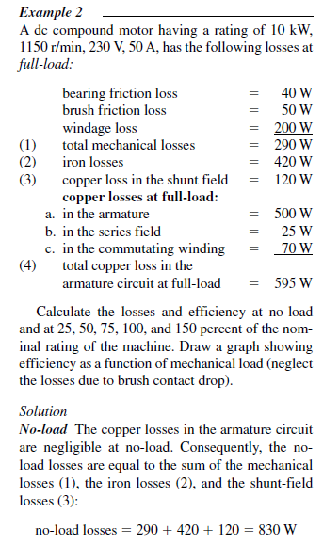
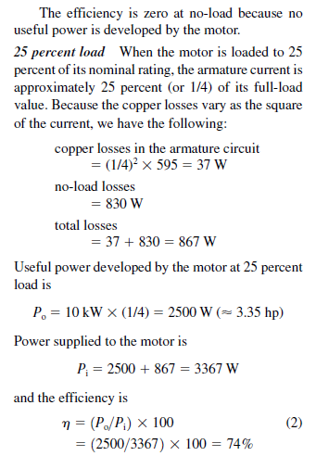
6.4 Efficiency curve

Slide 14
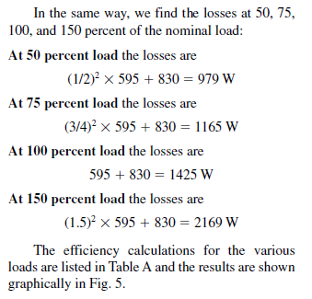
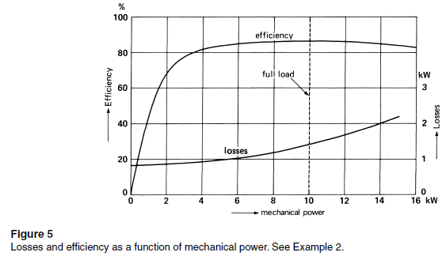
6.4 Efficiency curve

Slide 15
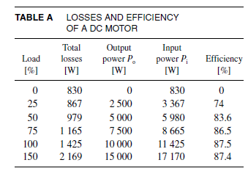
6.4 Efficiency curve

Slide 16
6.4 Efficiency curve
The efficiency curve rises sharply as the load increases, flattens off over a broad range of power, and then slowly begins to fall.
This is typical of the efficiency curves of all electric motors, both ac and dc. Electric motor designers usually try to attain the peak efficiency at full-load.
In the above calculation of efficiency, we could have included the losses due to brush voltage drop. Assuming a constant drop, say, of 0.8 V per brush, the brush loss at full-load amounts to 0.8 V x 50 x A 2 brushes=80 W. At 50 percent load, the brush loss would be 40 W. These losses, when added to the other losses, modify the efficiency curve only slightly.

Slide 17
6.4 Efficiency curve
It is important to remember that at light loads the efficiency of any motor is poor. Consequently, when selecting a motor to do a particular job, we should always choose one having a power rating roughly equal to the load it has to drive.
We can prove that the efficiency of any dc machine reaches a maximum at that load where the armature circuit copper losses are equal to the no-load losses. In our example this corresponds to a total loss of (830+830)=1660 W, an output of 11 811 W (15.8 hp) and an efficiency of 87.68 percent.

Slide 18
6.5 Temperature rise
Temperature rise of a machine= Warmest accessible part-Ambient temperature
Measured simply by using two thermometers but practically it is not possible.
Temperature has direct bearing on:
Power rating of the machine
Useful service life of machine

Slide 19
6.6 Life expectancy of electric equipment
Life expectancy of electrical equipment is limited by temperature of its insulation.
Higher temperature leads to shorter life and vise versa.
10 degree Celsius rise in temperature will half the service life.
Example

Slide 20
6.6 Life expectancy of electric equipment
Factors contributing to the deterioration of insulators are:
Heat
Humidity
Vibration
Acidity
Oxidation
Time
Organic insulators become hard and brittle on high T and then light shock will result into breakage of insulator , Low temperature cause freezing and cracking.
Moderate temperature is preferred for most of the insulators.

Slide 21
Factors that may shorten the service life of an insulator

Slide 22
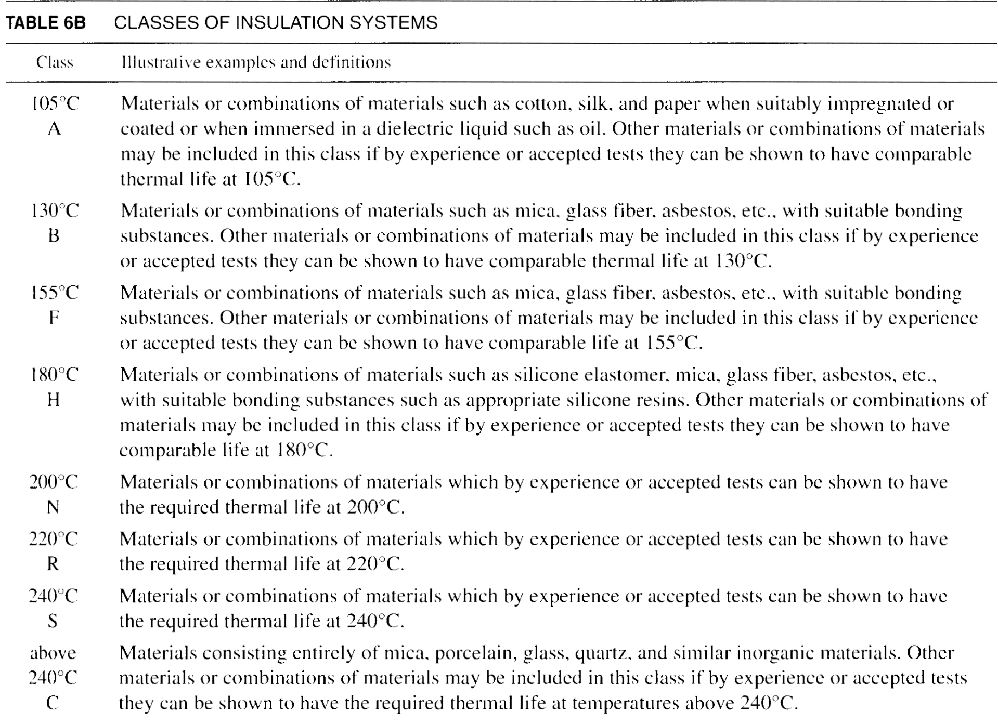
6.7 Thermal classification of insulators
Insulators are grouped into following classes depending upon their ability to withstand heat:

Slide 23
6.8 Maximum ambient temperature and hot-spot temperature rise
Standards organization have established a maximum ambient temperature (usually 40°C)
Standardization was done for manufacturers due to following reasons:
Enables them to foresee the worst ambient temperature conditions that machine is likely to encounter
Enables them to standardize the size of their machine and to give performance guarantees
Hottest-spot temperature must not exceed the maximum allowable temperature of particular class of insulation.

Slide 24
6.8 Maximum ambient temperature and hot-spot temperature rise
Machine Testing
Not to test in control environment of 40°C (can test anywhere from 10°C to 40°C)
Selling permission will be granted if temperature rise will be in specific range for particular class

Slide 25
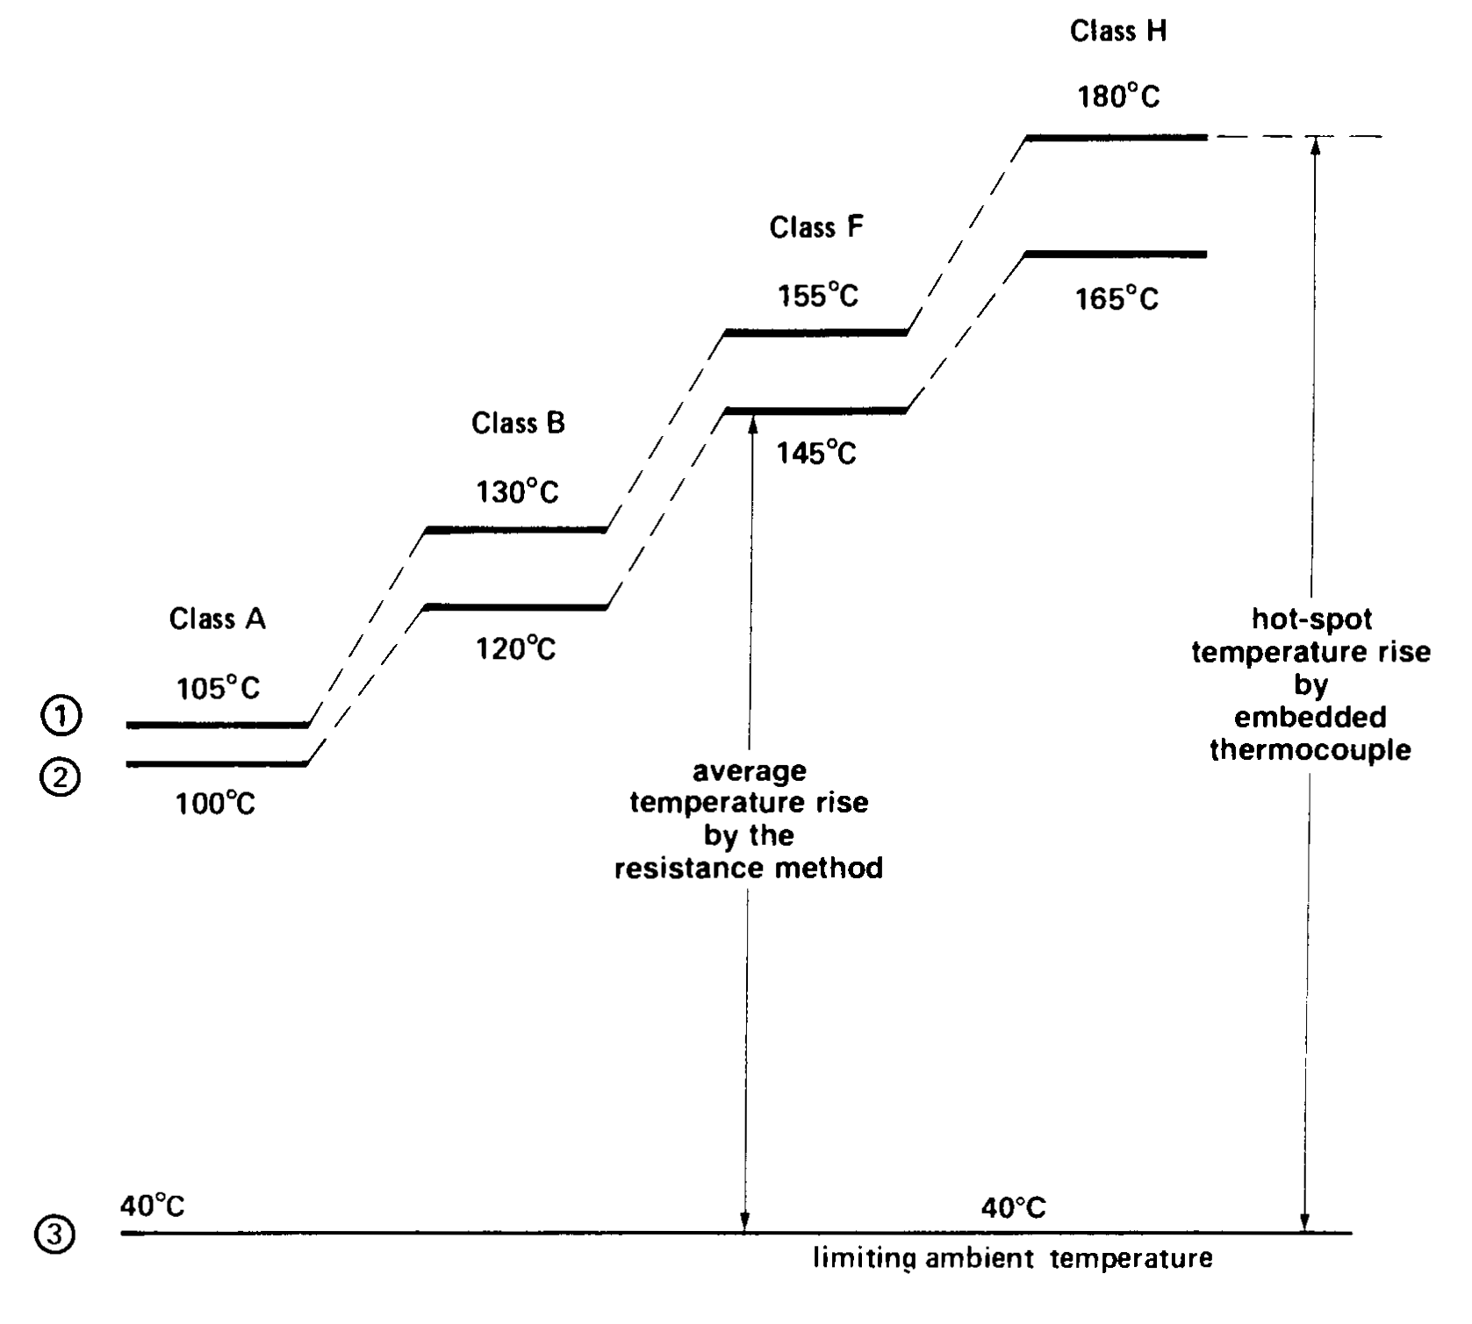
Curve 1 shows maximum permissible temperature of the insulation to obtain a reasonable service life
Curve 3 shows the limiting ambient temperature

Slide 26
Curve 2 shows the maximum permissible temperature using the resistance method

Slide 27
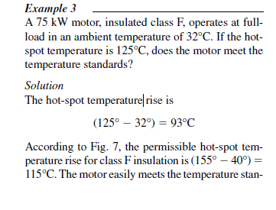
6.8 Maximum ambient temperature and hot-spot temperature rise
The manufacturer could reduce the size of the motor and thereby market a more competitive product.

Slide 28
6.9 Temperature rise by the resistance method
Hot-spot temperature rise is difficult to measure as it is to be somewhere inside of winding
Embed a temperature detector (Thermocouple or Thermistor) , costly method and is for large machines
Finding temperature rise by average winding temperature rather than hot-spot temperature

Slide 29
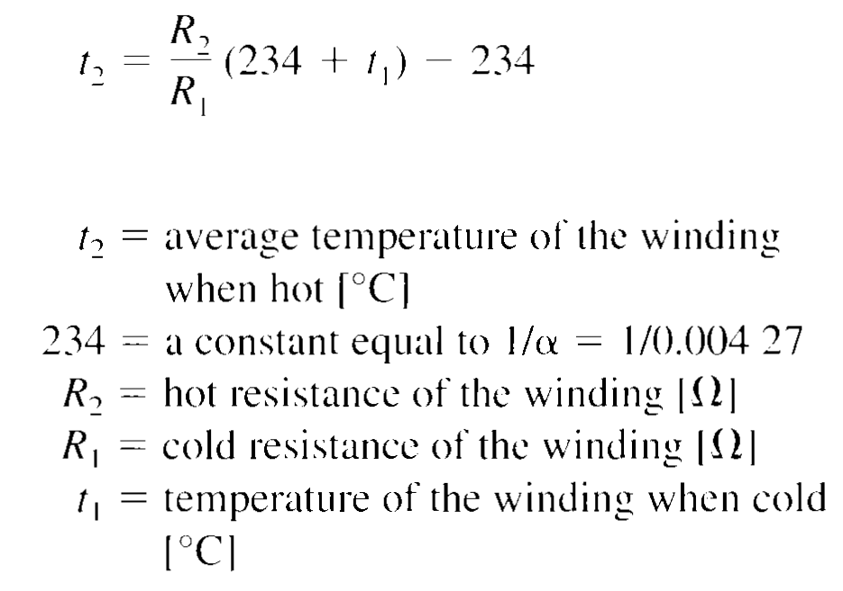
6.9 Temperature rise by the resistance method
Average temperature of a winding is found by resistance method:
Measure winding resistance at known winding temperature
Measure again when machine is hot
For copper we can use following equation to determine its average temperature:

Slide 30
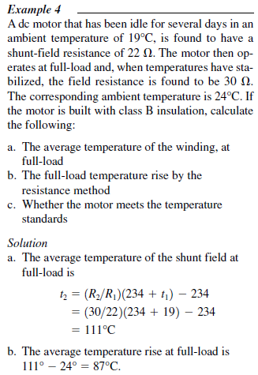
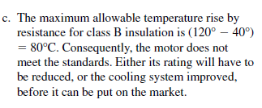

6.9 Temperature rise by the resistance method

Slide 31
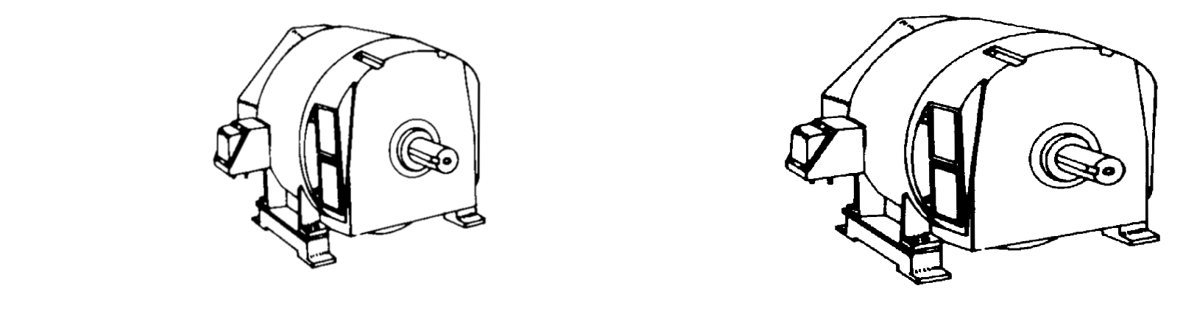
6.10 Relationship between the speed and size of a machine
100 kW, 2000 r/min motor ; mass : 300kg
100 kW, 1000 r/min motor ; mass : 500kg
Speed and size has Inverse relation
Example:100 kW, 2000 r/min motor has to generate same voltage but at half speed, what will happen with size

Slide 32
6.10 Relationship between the speed and size of a machine
100 kW, 2000 r/min motor ; mass : 300kg
100 kW, 1000 r/min motor ; mass : 500kg
Speed and size has Inverse relation
Low speed requirement will result into increase number of conductors on armature or field windings that will result into increase of machine size

Slide 33
Summary
Topics:
6.1-6.10
Examples:
6.1-6.4

